Slide 1


First draft of ALiSEA charter: clarification and approbation
First General Assembly
21st March 2017 – in Siem Reap

Slide 2
CONSULTATION PROCESS
Over the past year, several consultation workshops in different countries
ALiSEA project team combined all contributions and drafted this charter that aims at reinforcing members ownership
The charter is not a fixed document and could evolve in the future
Charter: A framework document defining shared vision, common objectives and member driven governance

Slide 3
ALiSEA VISION
An increased credibility and visibility of agroecology practices at family farmers, consumers and policy makers level spearheads the redesigning of the landscapes, the livelihoods and the mindscapes in the Mekong Region.
Such regional agroecology transition supports the emergence of healthy and resilient food systems and the creation of innovative and fulfilling jobs for the rural youth while sustainably preserving natural resources.

Slide 4
MISSION
ALiSEA is a network of Agroecology practitioners and supporters (sharing and supporting common goals on AE) that actively engages its members into information/knowledge sharing and vibrant collective actions promoting an AE transition, and providing visible benefit for all participants.
The network intends promoting a unifying agroecology concept for gaining higher visibility and influence, generating public support, and establishing a learning process to facilitate an agroecology transition in the region.

Slide 5
OBJECTIVES
To analyse current regulatory, socio-economic and institutional constraints in order to improve the environmental conditions for agroecology transition and development
To share learning from and capitalise on the knowledge and key experiences of different AE actors that are supporting farmers in their agroecological transition
To generate, aggregate and disseminate broad Information, Education & Communication materials (video, reports, handbooks) targeting farmers, development practitioners and consumers about agroecology

Slide 6
OBJECTIVES
4. To map outstanding agroecology sites across the Mekong region and to facilitate Farmer to Farmer and multi stakeholder visits
5. To assess local conditions, potentials, and build shared strategies for scaling up successful agroecology practices
6. To encourage / promote agroecology local and healthy food (building consumers’ confidence, private sector engagement and producers’ certification…)
7. To foster policy dialogue in order to include agroecology in national / regional strategies
8. To support co-development of performance indicators to assess agroecology impacts and facilitate its field testing

Slide 7
MEMBERS
Open coalition of stakeholders active on agroecology within the Greater Mekong Sub-region,
  Civil Society Organizations (Farmers’ Organizations, Local and International NGO, Consumer associations…)
  Research centers, universities, colleges and institutes with a research focus on agriculture and rural development
  Private sector operators
  Government agencies responsible for Agriculture, Fishery, Livestock, Forestry and Rural Development

Slide 8
Joining ALiSEA…
Members pledge
to respect ALiSEA charter and to actively engage in promoting an agroecology transition in the Mekong region through participation to experience & knowledge sharing and collective actions.

Slide 9
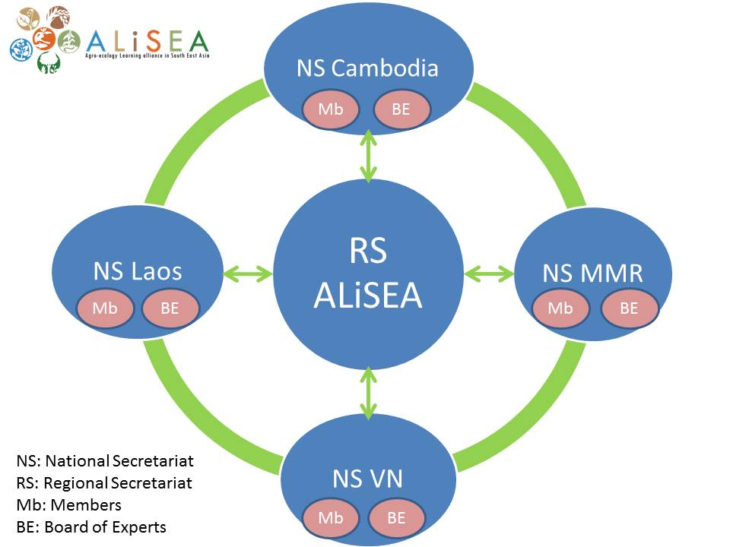
GOVERNANCE

Slide 10
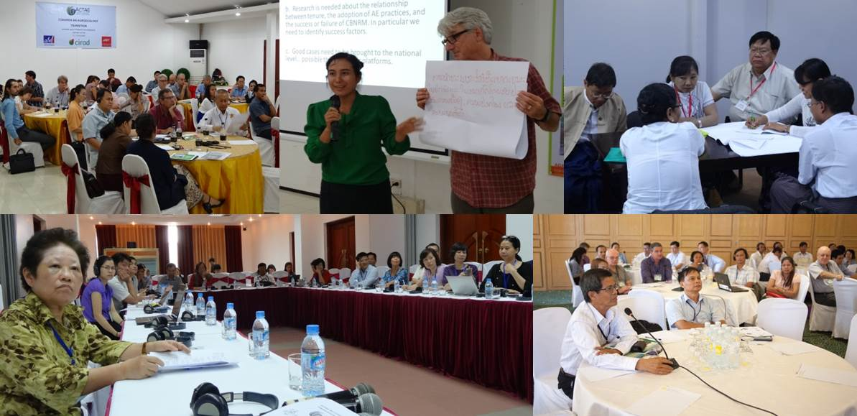
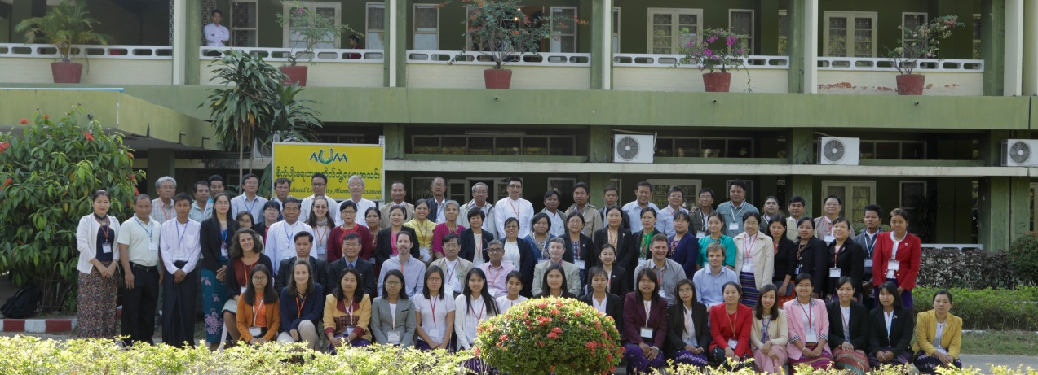
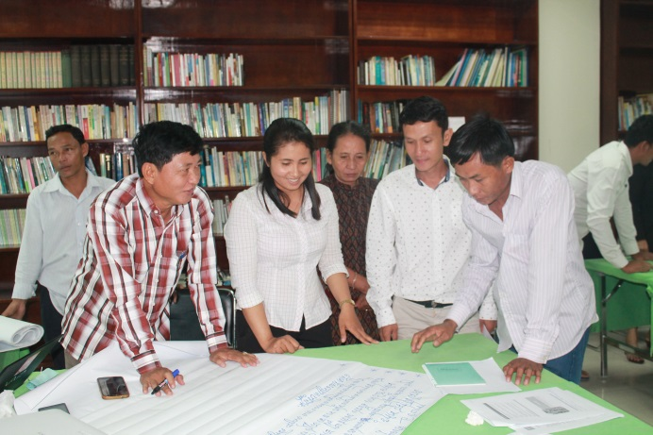
THANK YOU !

