Slide 1
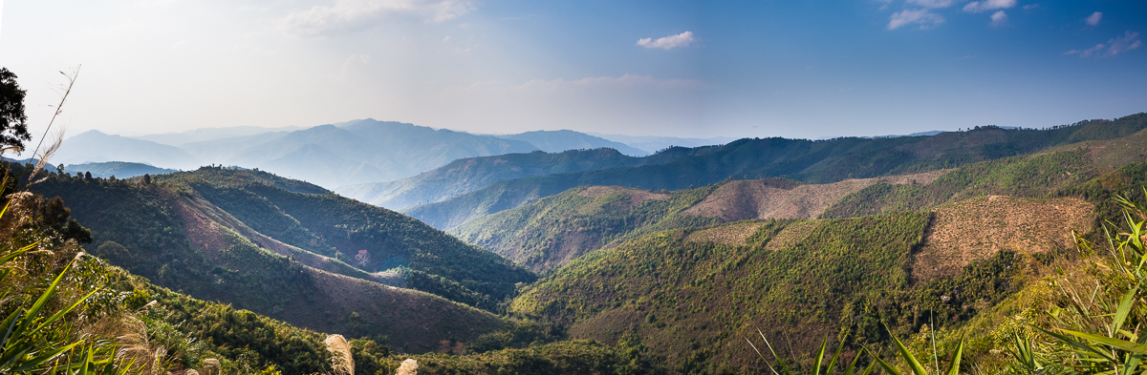








Forestry and Agro-Ecology in Lao rural Uplands (FORAE)
Viengkham District, Luang Prabang Province,
RDP Laos.
National multi stakeholder workshop “towards an agroecology transition”
2nd to 3rd of June 2016

Slide 2
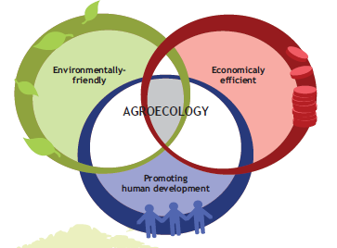
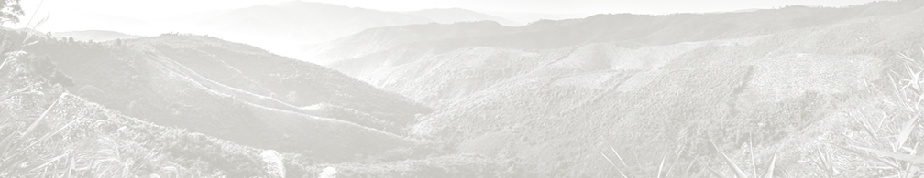
Agro-ecology in brief…
Agro-ecology is a systemic approach to agriculture, taking into account the economics of farms, but also environmental and social impacts of their activities, in order to insure their sustainability.
Limiting pressure on environment,
Sustainable management of natural resources
Creation of incomes
Improvement of agricultural productivity
Reduction of production expenses
Promotion of local knowledge/know-how
Food security and improvement of nutrition
Social and socio-professional organization enhancement

Slide 3
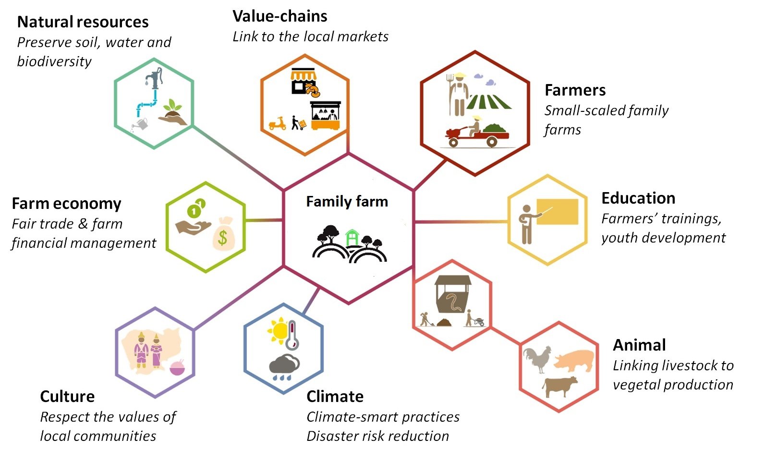
Agro-ecology in family farms…
When promoting Agro-ecology as a sustainable model of agriculture for family farming, we have to analyze how the farm is connected to its environment in order to propose adapted solutions to specific problems.

Slide 4

















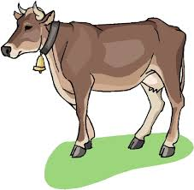
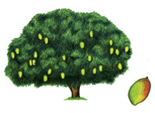


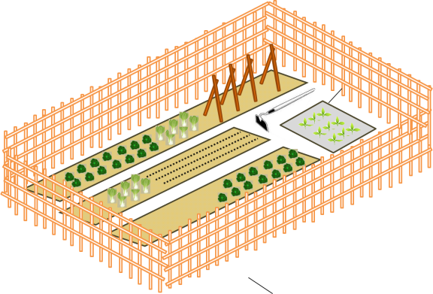

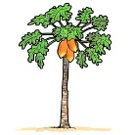




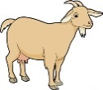

For example, in Viengkham District…
Reforestation and NTFP domestication
Protection of natural resources (soil, water, biodiversity)
Income generating activity
Green fence
Protect the soil against erosion and crop against roaming animals
Fruit trees plantation
Food diversification and income generating activity
Home gardening
Food diversification and income generating activity
Crop association and improved fallow
Soil fertility and yield improvement
Expected results:
Land-use planning
Protection of natural resources
Improvement of family incomes
Improvement of family food security
Climate-change mitigation
Problematics:
Erosion and low soil fertility
Poor livestock management
Decrease of water quantity and quality
Food insecurity
Livestock pasture
Improve big livestock nutrition and health
Rotational crops on slopes
Decreasing
forest cover
Malnutrition and low food diversity
Roaming animals in the village and the fallows
Low access to clean water

Slide 5

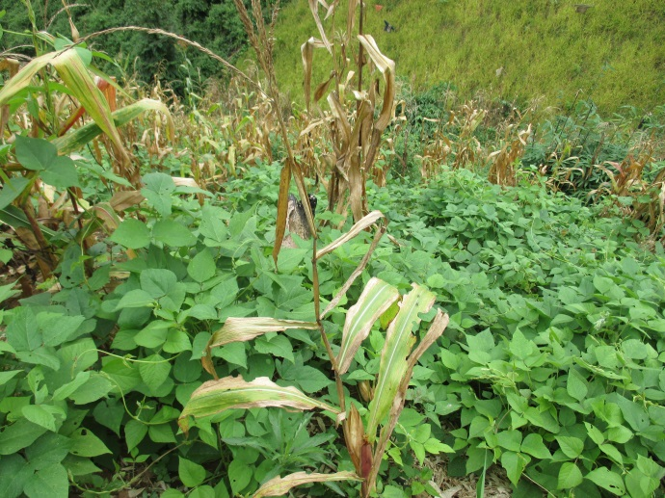
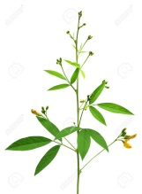
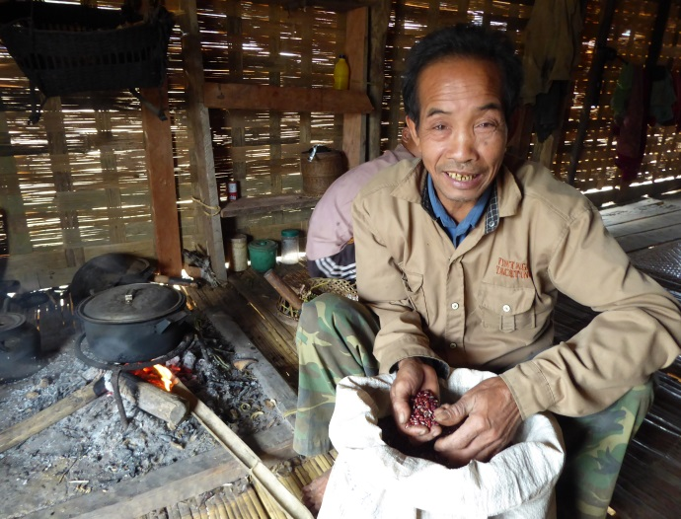
Challenges:
Additional labour work for leguminous seeding
and harvesting
Roaming animals destroying leguminous crops
Vulnerable to rats and lack of water
Need new market opportunities for leguminous
Expected results:
Improvement of soil fertility
Decrease of soil erosion and soil losses
Protection against roaming animals
  Crop diversification and better nutrition
  Additional sources of incomes
Food crops
Agro-ecology practices:
Cover crops with rice bean
Intercropping of leguminous with food crops (peanut, soy bean)
Green fence

Slide 6
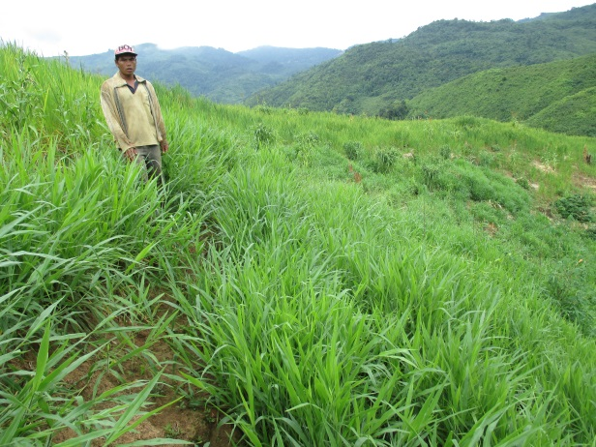
Challenges:
High costs for fencing (labour and materiel)
Lack of motivation to create collective pasture area (prefer individual)
Low access to inputs, such as fodder seeds and barbwires
Agro-ecology practices:
Animal pasture at village scale
Green strips on contour lines with nepia and guinea grasses
Green fence
Expected results:
Animal control and Health improvement
Soil protection against erosion
Village Land Use Planning implementation
Improvement of family incomes
Animal fodder

Slide 7
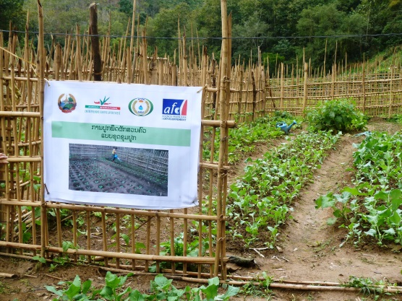
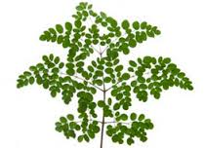


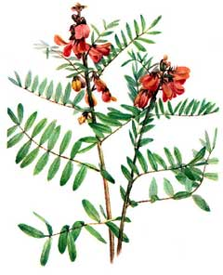









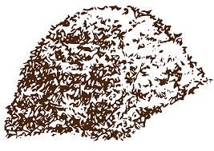
Challenges:
Lack of water for irrigation
Lack of manure for fertilization (roaming animals)
Lack of space for gardening within the village area
  Agro-ecology practices:
  Production of organic fertilizers
  Water-saving techniques: bowl farming and mulching
  Crop associations
  Integrated pest management: production of bio-pesticides, repellent plants...
  Off-season production: raised nursery
Vegetable gardening
  Expected results:
  Crop diversification and better nutrition
  Additional sources of incomes

Slide 8

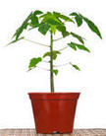
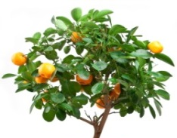
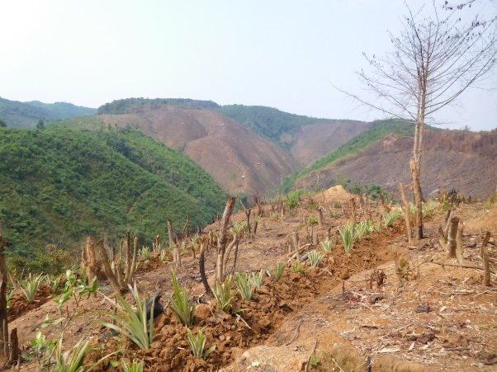
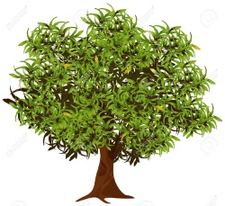
Agro-Forestry
Challenges:
Lack of maintenance on fruit trees (low fertilization and weeding)
Additional labour work to install the contour lines
High mortality on transplanted wild stock (rattan)
Difficulty to protect NTFP against roaming animals
Long-term investment for farmers before generating incomes
  Agro-ecology practices:
  Plantation of fruit trees
  Fruit tree orchards following contour lines
  NTFP domestication
  Maintenance: Bamboo fence, biopesticides, mulching, cutting….
  Expected results:
  Crop diversification and better nutrition
  Additional sources of incomes
  Protection of vegetal biodiversity and forest cover

Slide 9
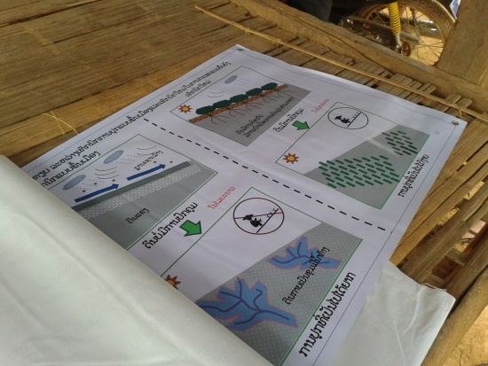
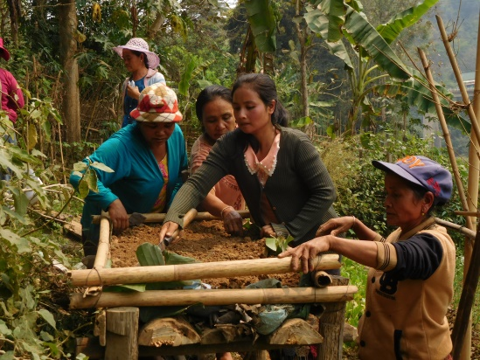
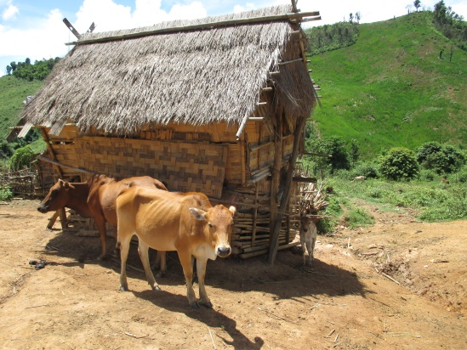
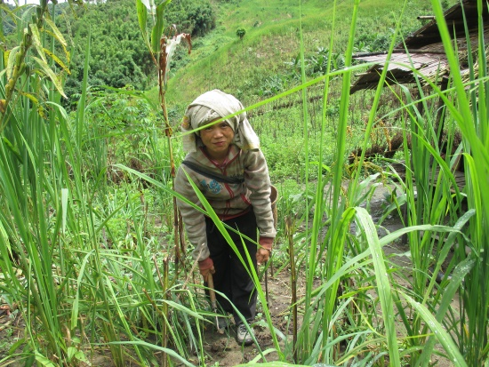
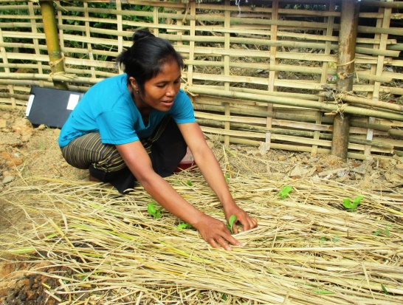
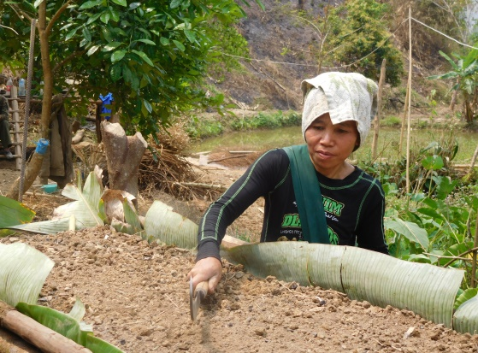
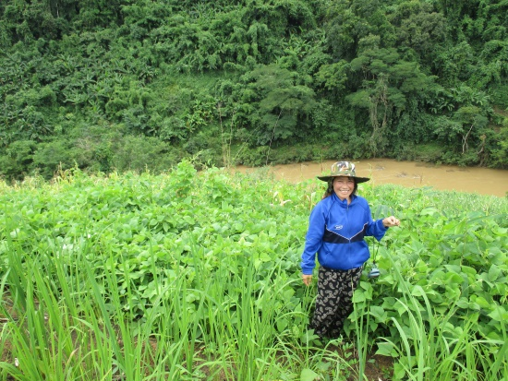
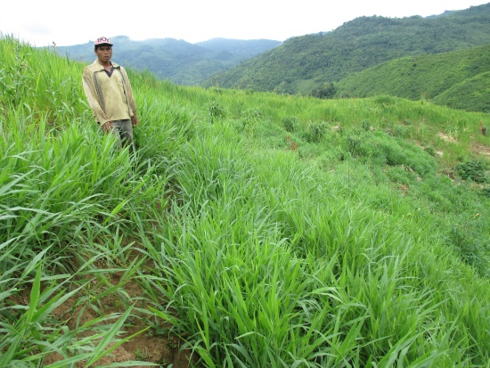
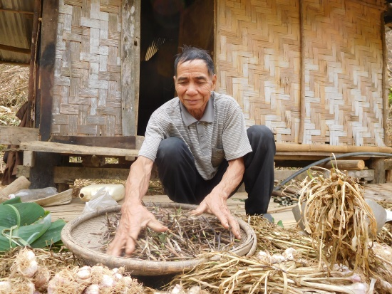
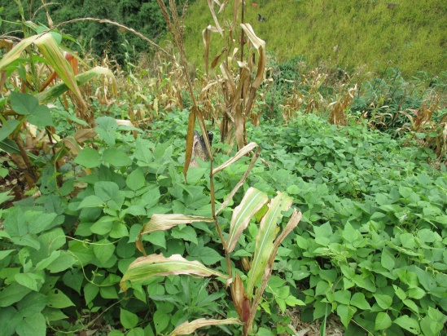
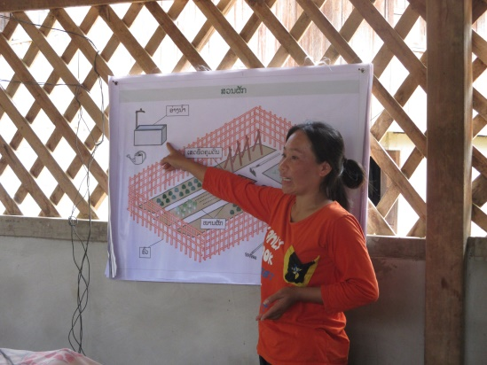
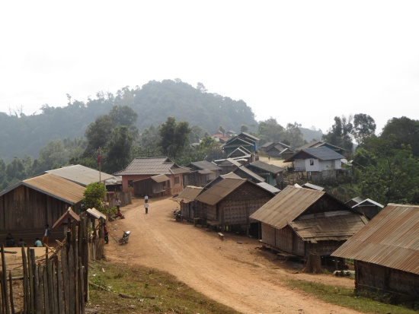
ຂອບໃຈ
ມີຄຳຖາມບໍ່?

