Slide 1
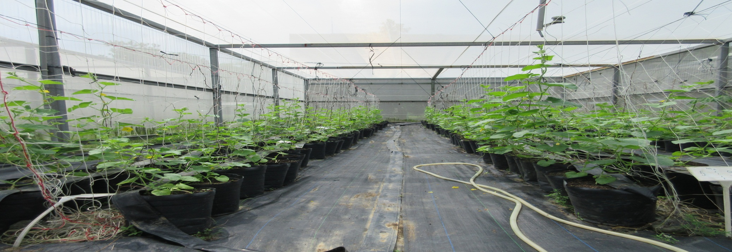
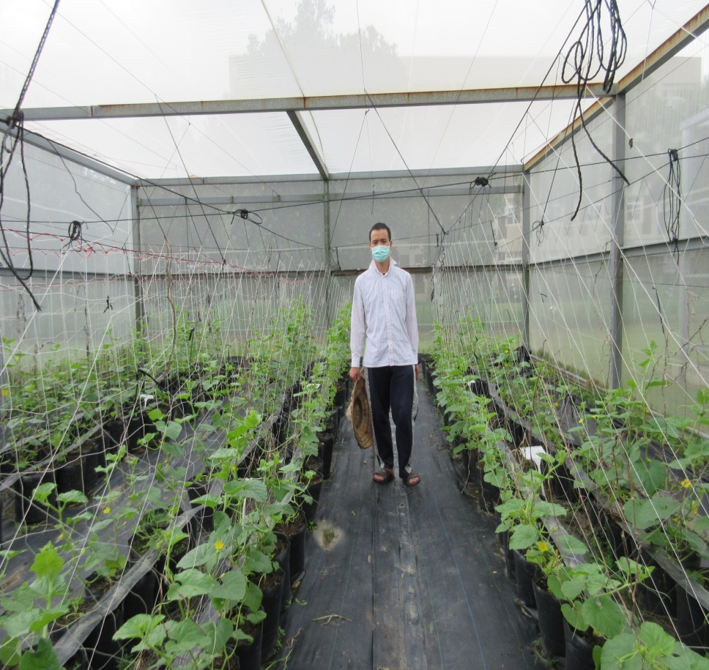
Effects of organic materials on soil properties, growth and yield of honeydew melon (Cucumis melo L. inodorus)
Nguyen Van Tam, Ph.D
Thai Nguyen University of Agriculture and Forestry
Cell phone: (+84)986 879 896
Email: nguyenvantam@tuaf.edu.vn

Slide 2
Contents
1. Introduction
2. Objective
3. Material and Method
4. Result and Discussion
5. Conclusion

Slide 3
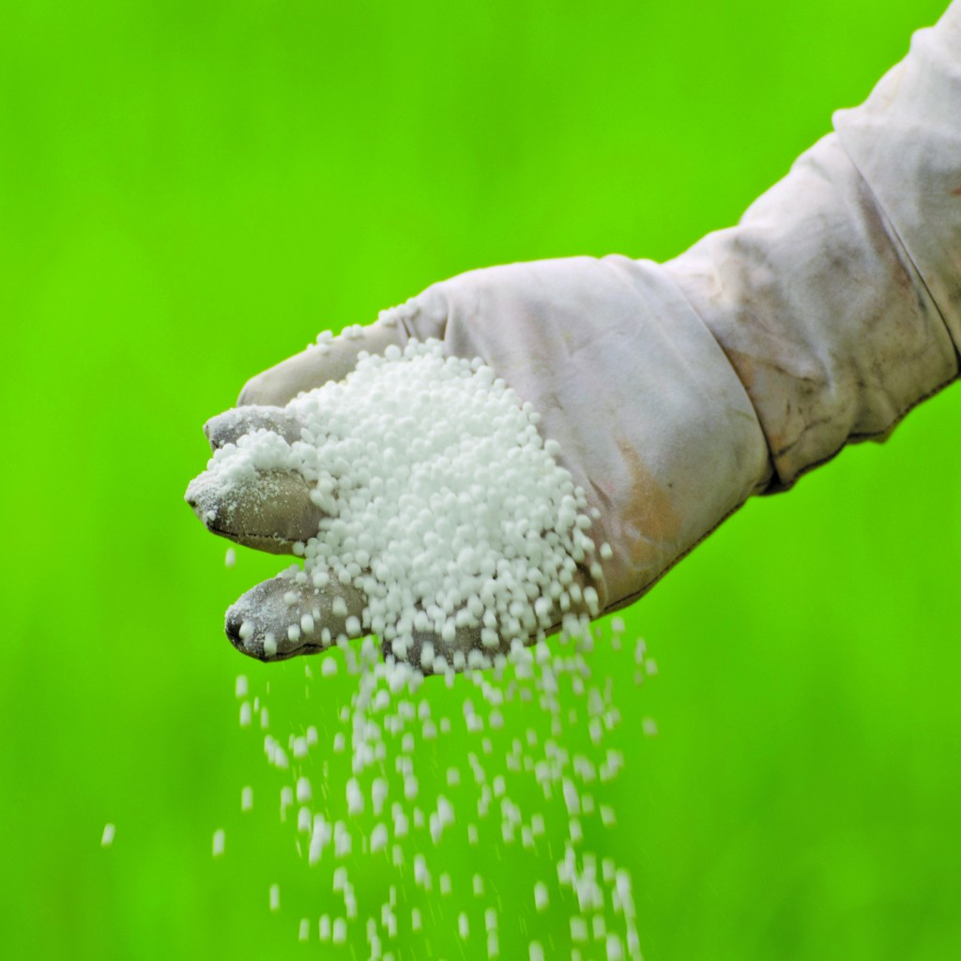
1. Introduction
Nowadays, crop yield and soil productivity reduced to considerable levels due to decreased organic matter contents along with use of dense fertilizers.
In order to solve these problems, improvement of soil structure by using organic materials is one of the most effective solutions. Among organic materials, spent mushroom substrates (SMS) and vermicompost (VC) are considered efficiently.

Slide 4
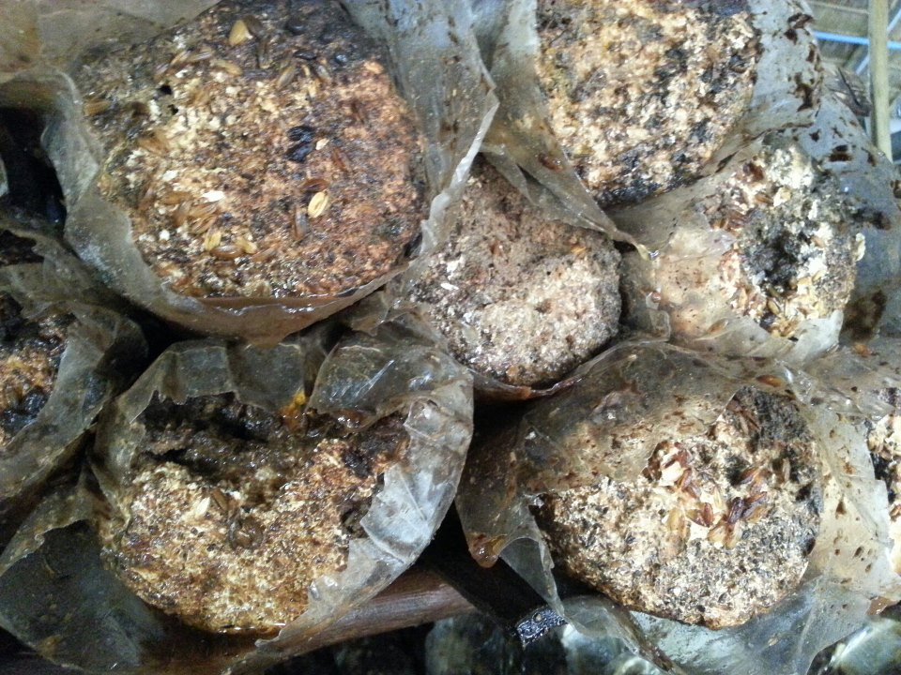
1. Introduction
SMS has been also identified as a potential material in agricultural production, especially in organic agriculture.
SMS contains a high value of nutrients that is harmless to plants and was also determined as a rich source of humus which helps maintain soil structure such as improving soil water holding capacity, soil aeration … and provides nutrients for plants

Slide 5
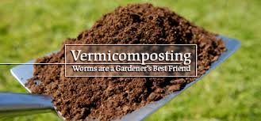
1. Introduction
VC has many excellent characteristics, especially it is a rich source of bacteria, fungi, and microorganisms
Moreover, VC contains most nutrients in forms that are easily taken by plants such as phosphorus, potassium, nitrates, and magnesium
In agriculture production, SMS and VC have been widely studied. However, there are few studies to determine effects of SMS and VC combination on crops.

Slide 6
2. Objectives
Evaluating effects of SMS and VC on the soil properties, growth and yield of honeydew melon.
Determining the best rates of SMS and VC for honeydew melon production in organic agriculture.

Slide 7
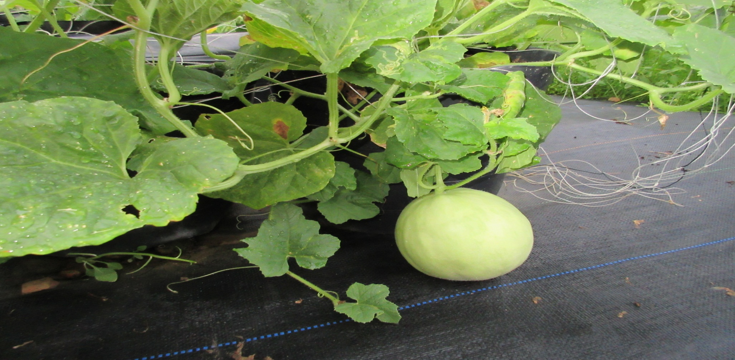
3. Materials and Methods
3.1. Materials
Seedling: My experiment used the honeydew melon variety: Huigu from Known You Seed Company Ltd.

Slide 8
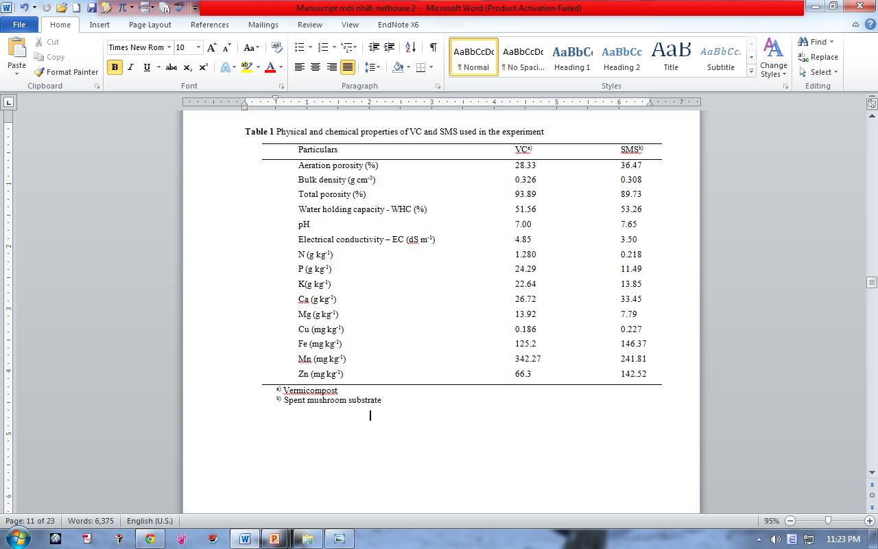
3. Materials and Methods
Organic materials: The organic materials used in the experiment were SMS and VC

Slide 9
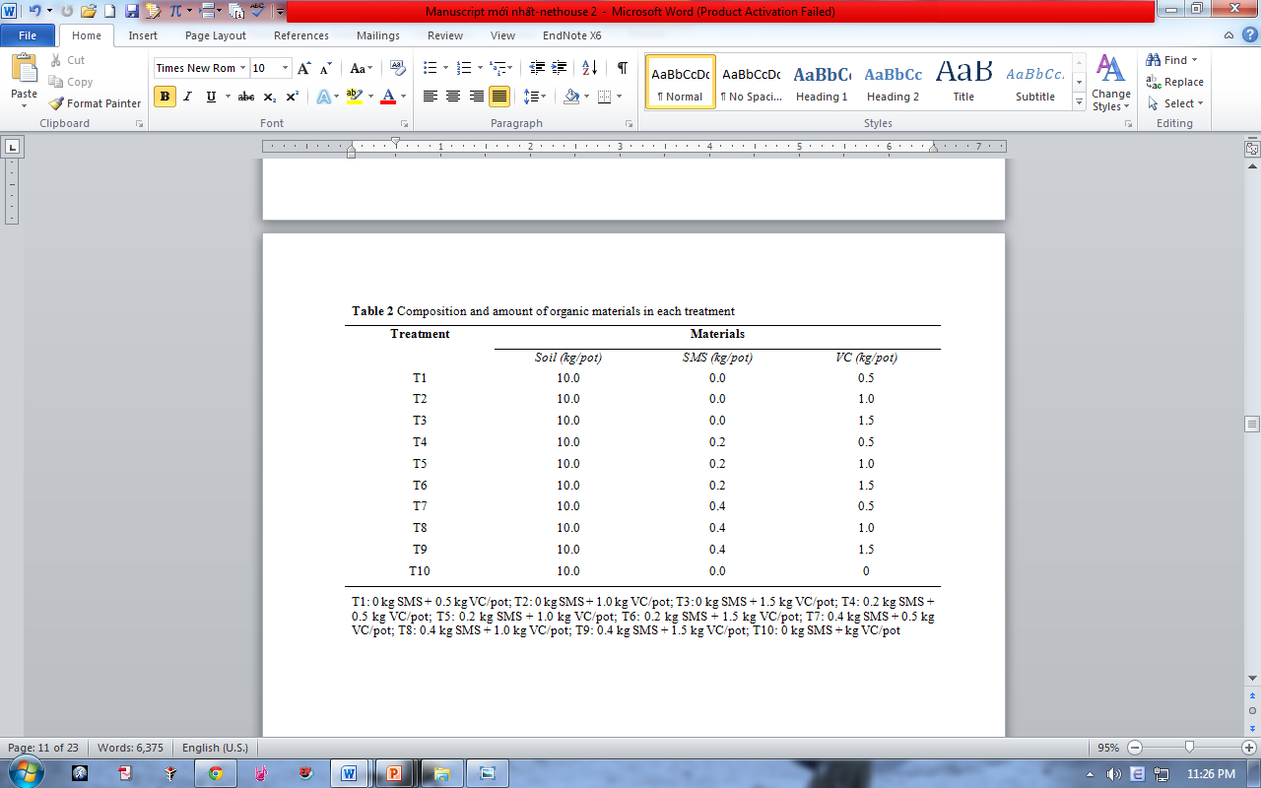
3. Materials and Methods
The experiment was arranged in a complete random block design (RCBD) with10 treatments and three replications. Composition and amount of materials in each treatment was showed in Table 2

Slide 10
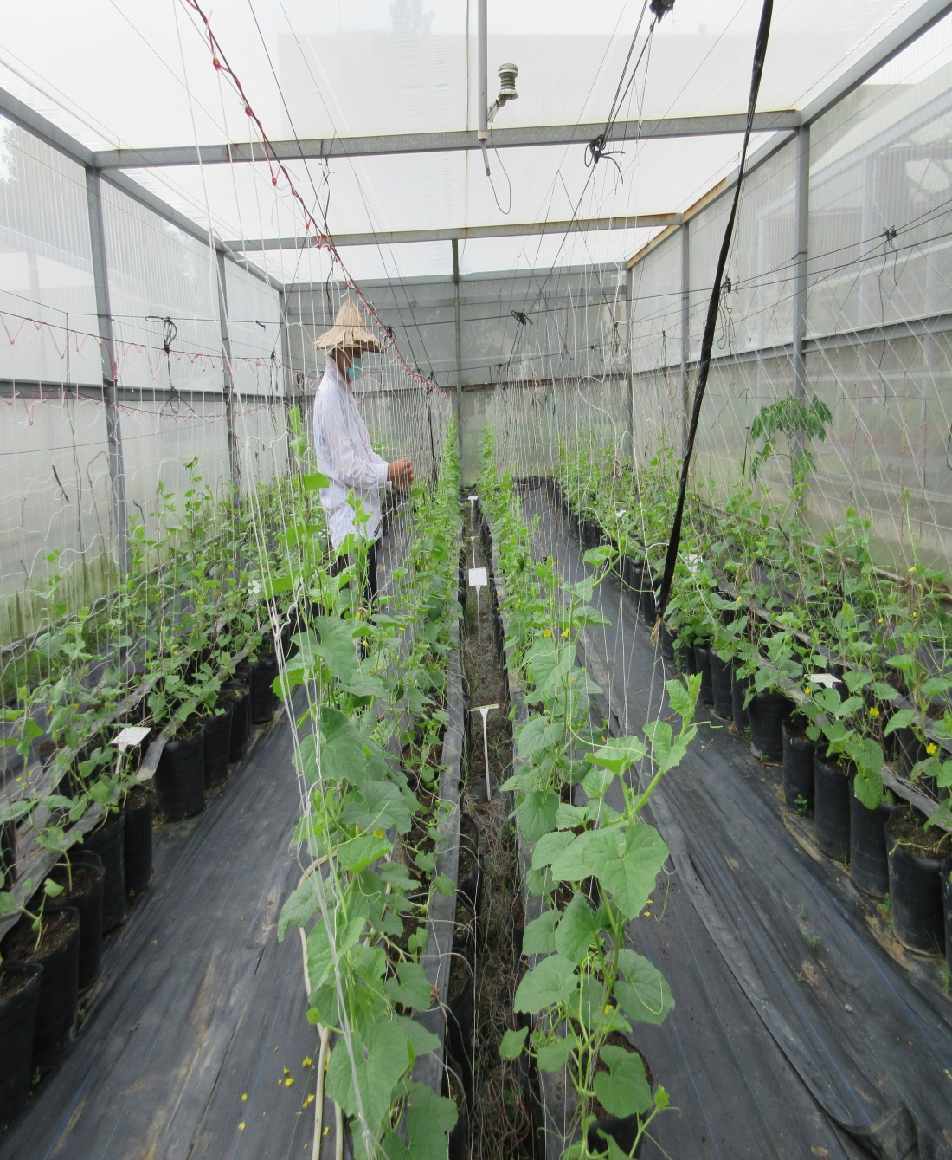
3. Materials and Methods
3.2. Methods
Cultivation
SMS and VC were manually applied two weeks prior to transplanting. All treatments were not provided by additional fertilizer. One seedling was grown in each pot. When the fruits developed on some first nodes of the lateral, all laterals and female flowers were removed up to the 7th node. Each plant maintains only one fruit and one single stem.

Slide 11
3. Materials and Methods
Sampling methods
At the flowering stage, three plants per each replication were harvested. They were dried by an oven during 48 hours and then ground to measure the nutrient uptake of honeydew melon plants.
After two weeks of applying organic materials, at flowering stage, and at harvesting stage, soil samples were collect from each treatment. After drying soil samples at room temperature, they were ground to pass through a 2 mm sieve. They were used to analyze pH, EC, OM, and macronutrient content.

Slide 12
3. Materials and Methods
Measuring physical and chemical properties of soil
pH - according to the method of Cavins (2000) by using a pH meter (UltraBasic-UB10)
OM- according to the method of Navarro (2009) by loss on ignition at 430⁰C for 24h
Available phosphorus (P) were measured by using Walkley-Black wet burning method reported in (Jackson, 1962).
The mineral- N concentration was determined by the colorimetrical methods of Sims et al. (1995) by using a modified indophenol blue technique.
The nutrient elements P, K, Ca, Ma, Fe, Mn, Zn, and Cu, 5g of samples were extracted with 0.1N HCl, and then analysed by inductively coupled plasma atomic emission spectroscopy.

Slide 13
3. Materials and Methods
Measuring morphological growth of plants
Plant height was measured with a ruler from the cotyledon to the maximum height of the shoot.
Number of leaves per plant was also counted
Leaf area was estimated from relationship with the length and the width of the central leaves as reported by Blanco and Folegatti (2003)
Chlorophyll content was measured by using a portable SPAD meter
Measuring parameters of yield
Fruit weight was measured gravimetrically using a precision balance model Mettler Toledo Classic light1501-S.
Fruit length and fruit diameter were measured with a ruler

Slide 14
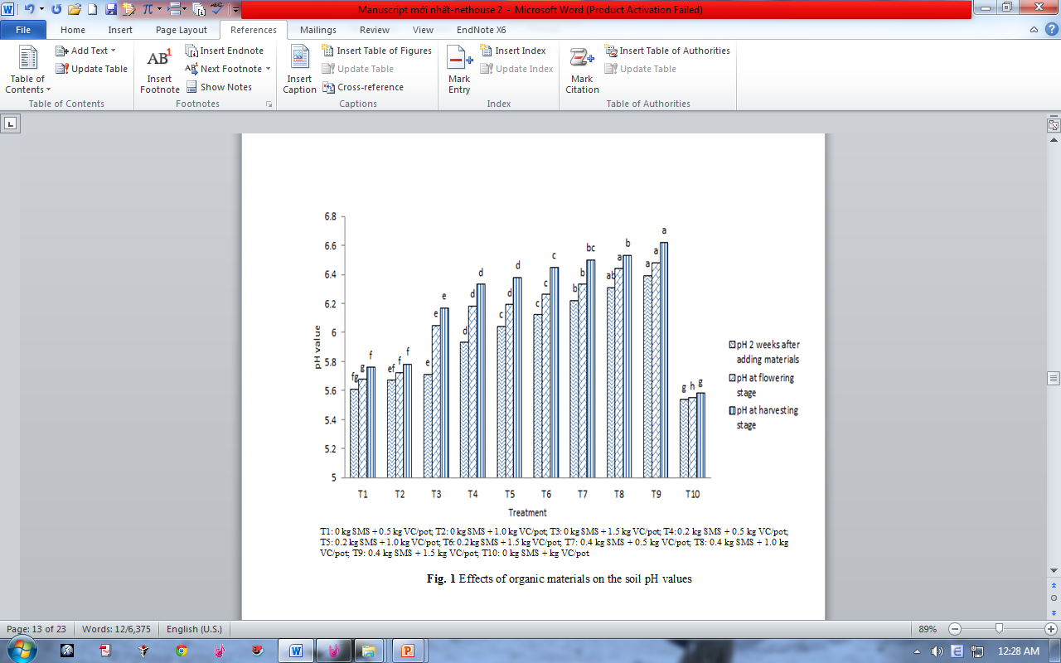
4. Results and Discussion
SMS and VC with a high Ca content can effectively combat aluminum toxicity and raise pH levels.
4.1. Effects of organic materials on pH, EC, and OM of the soil
Fig. 1 Effects of organic materials on the soil pH values

Slide 15
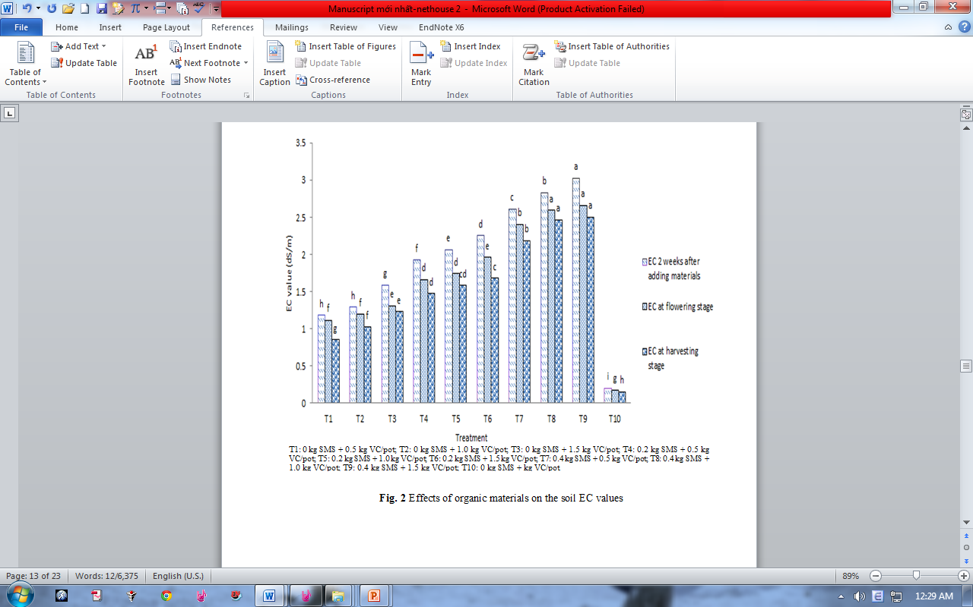
4. Results and Discussion
This fact was attributed to salts which were released during decomposition of organic materials.
This result is due to the high EC of SMS and VC
Fig. 2 Effects of organic materials on the soil EC values

Slide 16
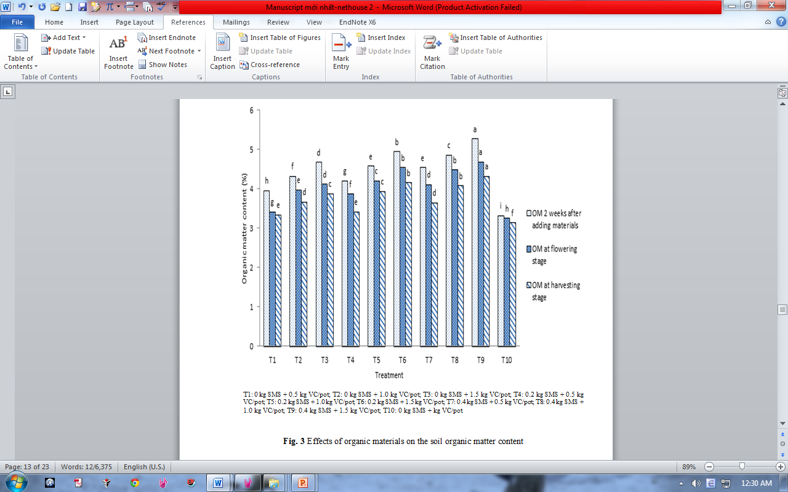
4. Results and Discussion
This fact was attributed to the high OM values of SMS and OM.
Moreover, VC is products that accelerates the rate of decomposition of organic matter leading to a rapid humification process (Mathivanan et al. 2013)
Fig. 3 Effects of organic materials on the soil organic matter content

Slide 17
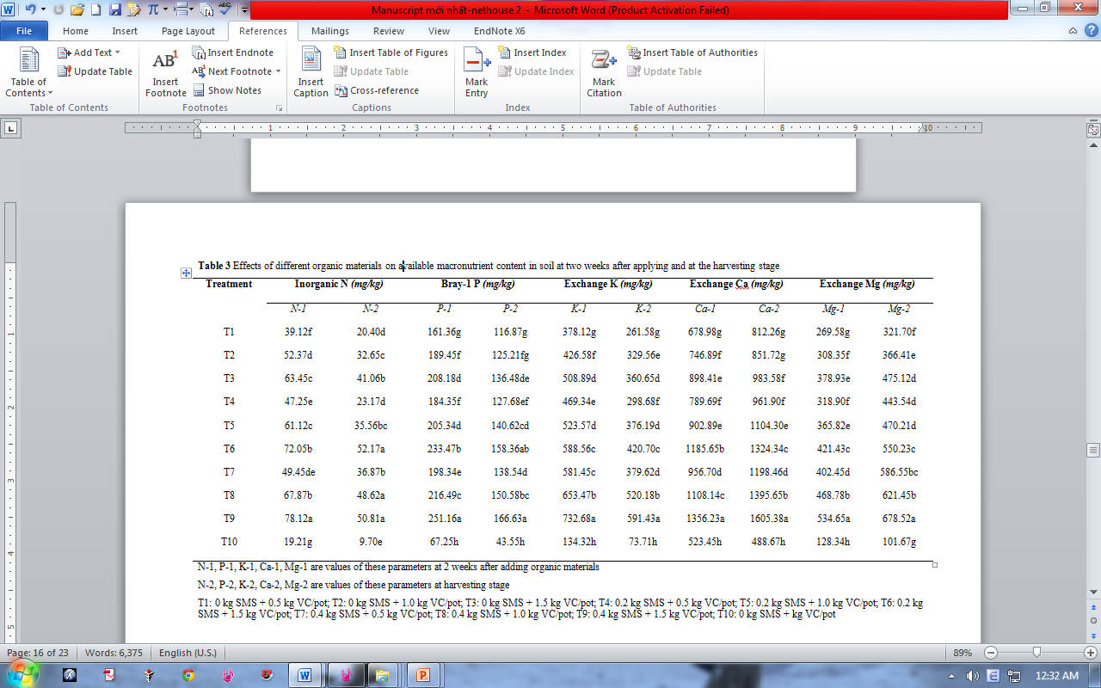
4. Results and Discussion
This fact was attributed to uptake of nutrients by plants and leaching due to irrigation and rainfall.
4.2. Effects of organic materials on macronutrient content in the soil
Table 3 Effects of organic materials on available macronutrient content in soil at two weeks after applying and at the harvesting stage
This result was distributed by the mineralization of OM derived from SMS and VC.
This fact was due to the use of a high proportion of SMS and VC, characterized by high P and K concentration.

Slide 18
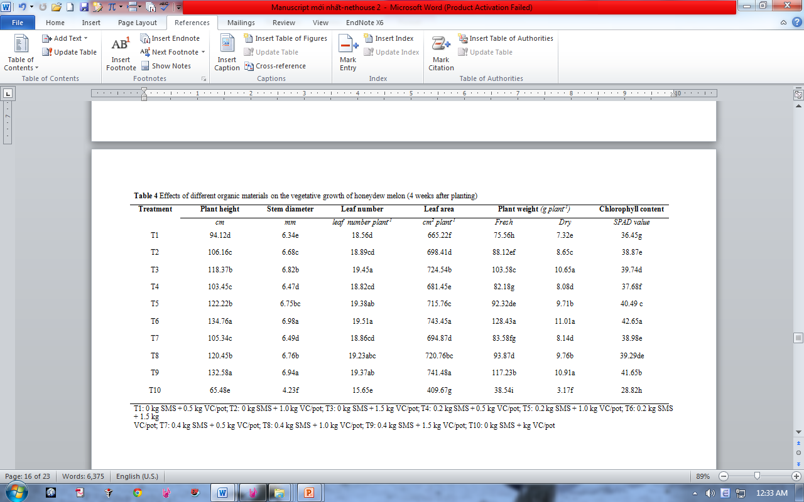
4. Results and Discussion
SMS and VC had positive impact on honeydew melon growth due to two reasons: 1) the higher concentration of macronutrients supplied by SMS and VC. (2) better availability of humic acid and plant growth regulators in SMS and VC, which is produced by the increased activity of bacteria, fungi.
4.3. Effects of organic materials on plant growth parameters
Table 4 Effects of organic materials on the vegetative growth of honeydew melon (4 weeks after planting)

Slide 19
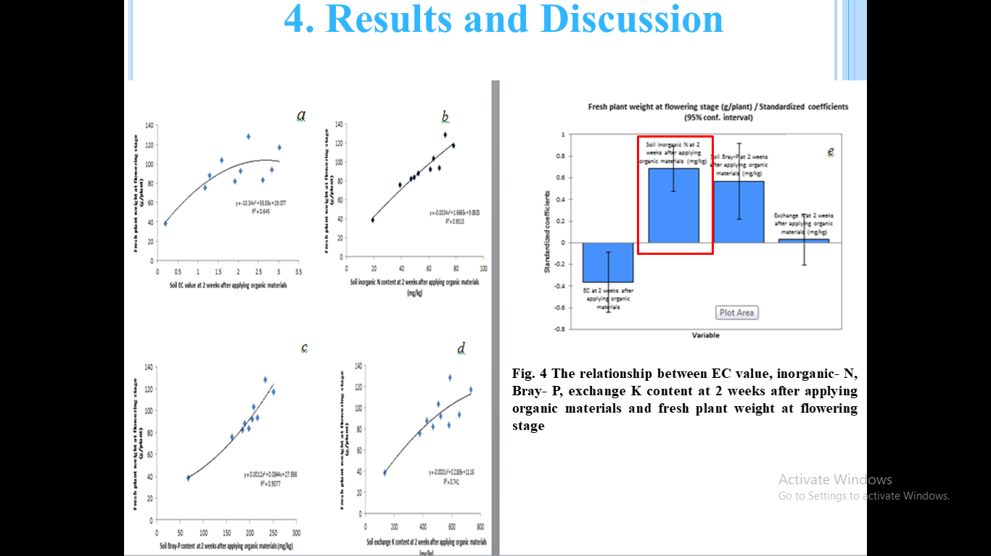
4. Results and Discussion

Slide 20
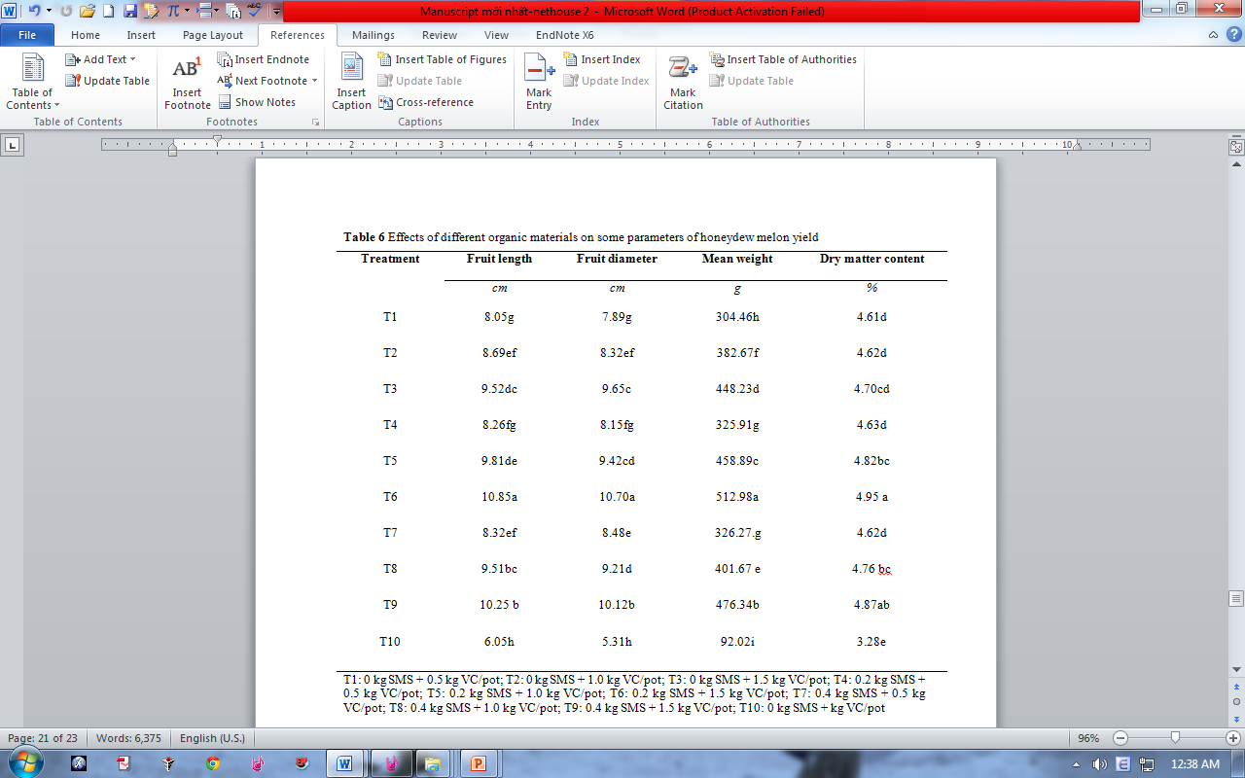
4. Results and Discussion
4.4. Effects of organic materials on some yield parameters
Table 5 Effects of organic materials on some parameters of honeydew melon yield
This result was attributed to variable growth attained by plants, due to different rates of release of growth-promoting soils owing to different proportions of SMS and VC

Slide 21
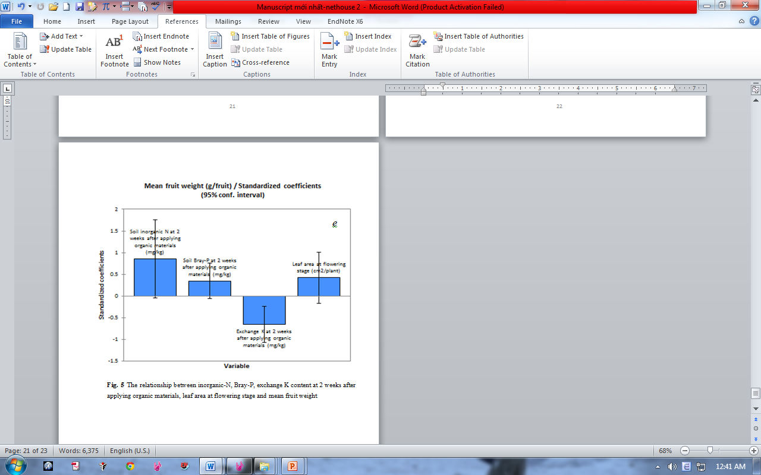
4. Results and Discussion
Fig. 5 The relationship between EC value, inorganic- N, Bray- P, exchange K content at 2 weeks after applying organic materials, leaf area at flowering stage and ,ean fruit weight

Slide 22
5. Conclusion
There were significant changes in soil properties such as increasing pH, OM, EC and macronutrient concentration as a result of SMS and VC amendment.
Application of SMS and VC is very useful for higher vegetative growth, better nutrient uptake, and it helps in getting higher mean fruit weight in honeydew melon production .
The rate of 0.2 kg SMS + 1.5 kg VC/pot is sufficient for higher productivity of honeydew melon in organic agriculture.

Slide 23
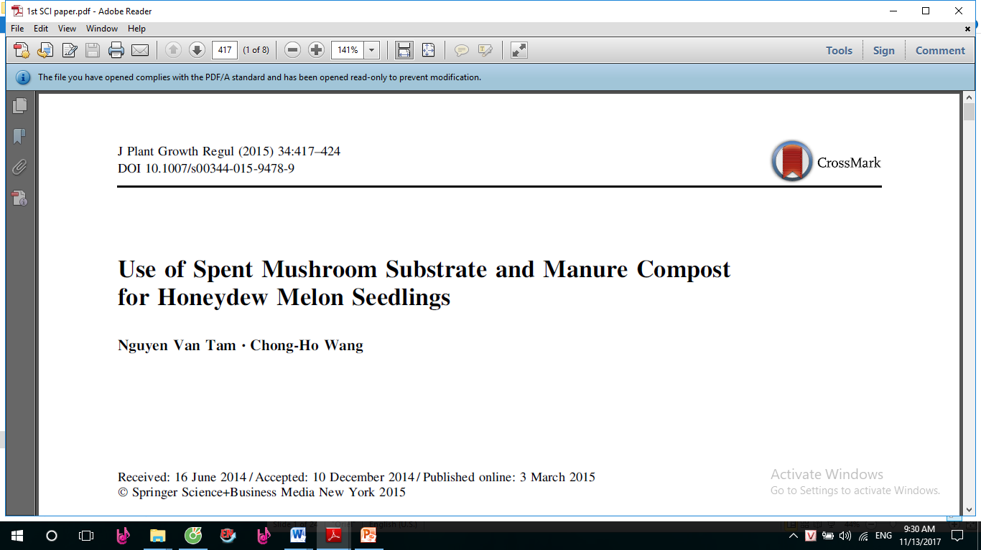
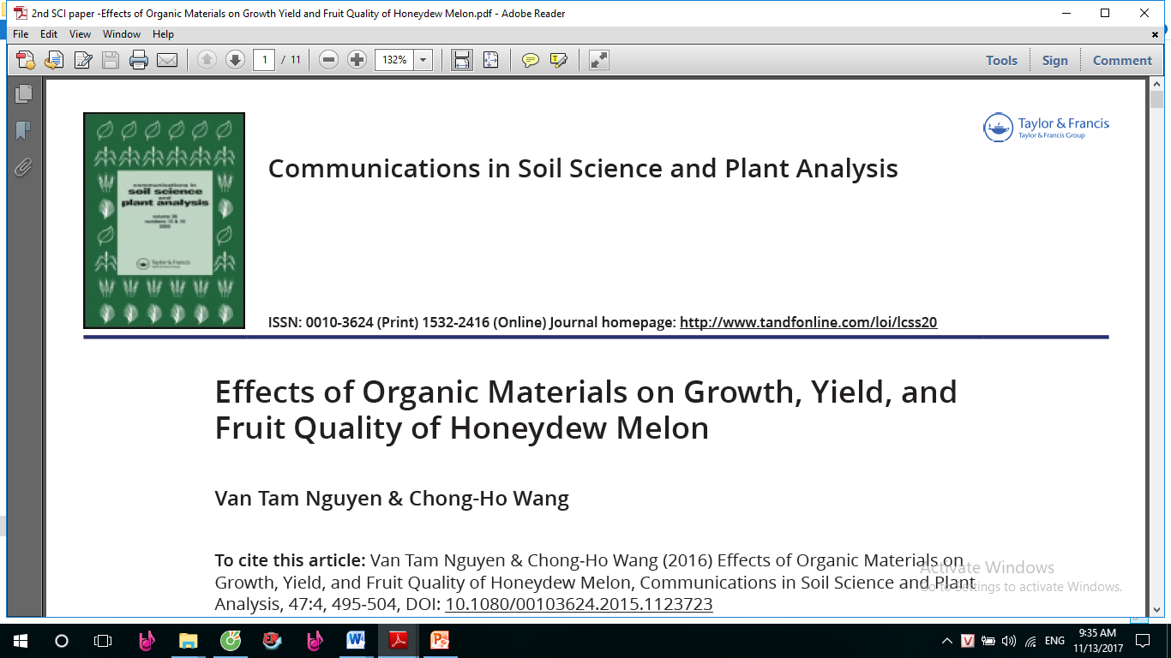
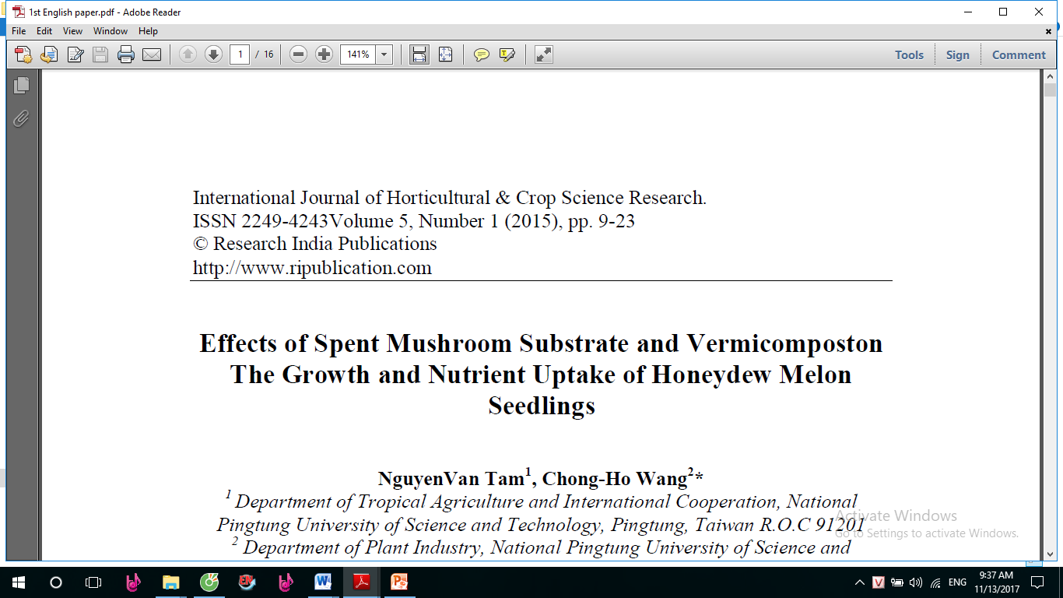
Thank you for your attention

